Slide 1


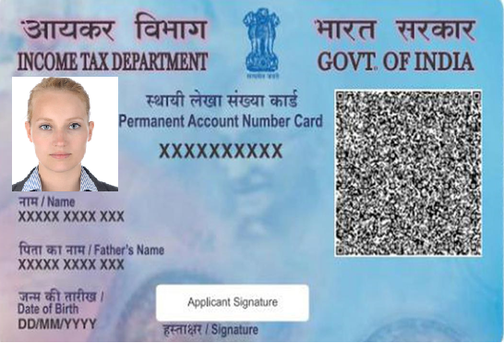



Altruist PAN card
Paperless Application
Altruist confidential and proprietary

Slide 2
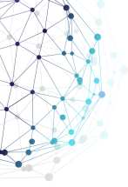
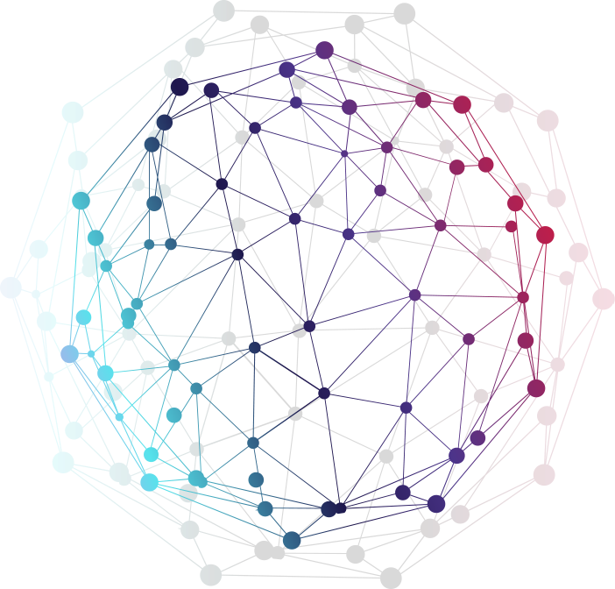
PAN Application
Benefit of Paperless Process
This is the fastest process of Appling for PAN card.
This can be completed in less than 10min .
ePAN is received by the Customer within 2hrs.
This application is available on both mediums
WEB
Mobile
Basic required from client
Aadhaar card
Mobile No. (Linked to Aadhaar) or he can use Biometric authentication
Client will receive the Acknowledgement no. on his Mobile/Email as soon as the process is completed and ePAN within 2hrs.
Altruist confidential and proprietary
Altruist confidential and proprietary

Slide 3
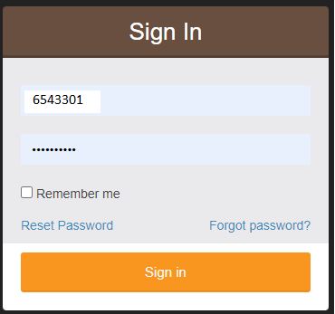
Paper less PAN process
Login to Altruist site : https://pan.altruistindia.com/
With your login and Password
Altruist confidential and proprietary
Altruist confidential and proprietary

Slide 4
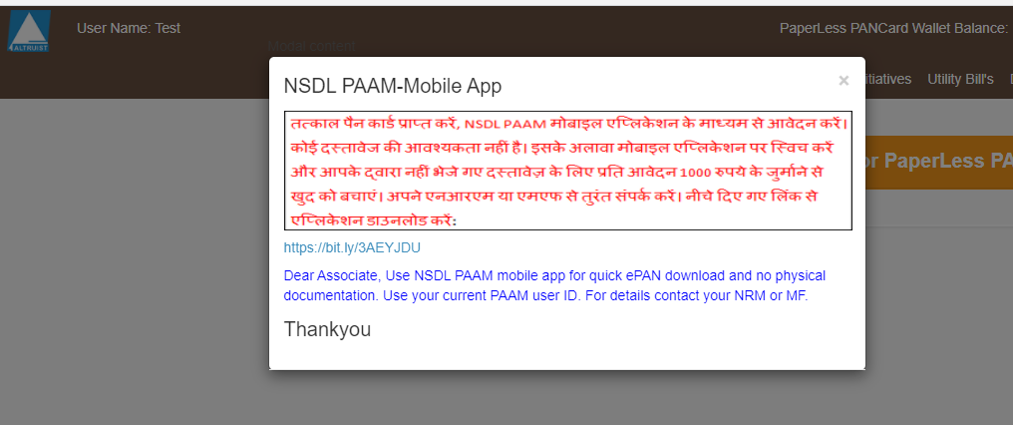
Check the X mark to close this notice board
Altruist confidential and proprietary
Altruist confidential and proprietary

Slide 5
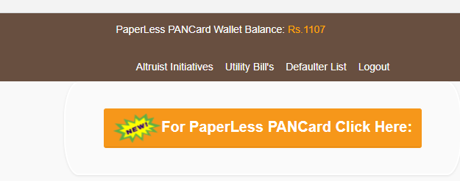
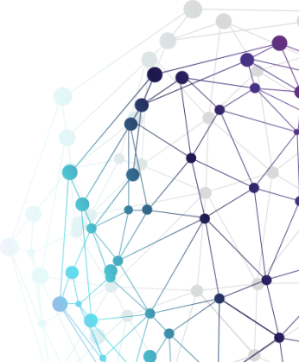
Check Balance and refund
Your current Balance will be shown on the top of the screen.
A minimum balance of 107/- Rs is mandatory to start the process .
Click on New paperless PAN card to fill in the application.
If you are unable to complete the application due to any reason the balance will be refunded in in you account within 30 minutes.
Altruist confidential and proprietary
Altruist confidential and proprietary

Slide 6
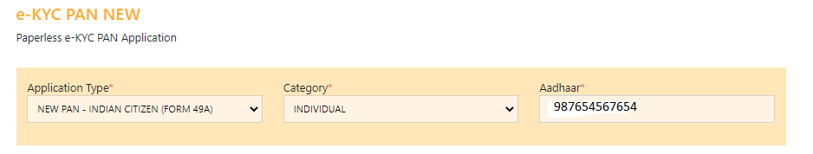
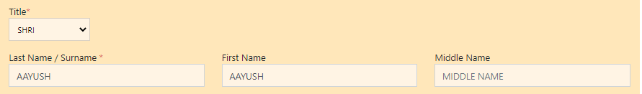
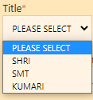
Filling the details of AAdhaar
Message : -Redirecting to Pan Application
Fill in the below details
Altruist confidential and proprietary
Altruist confidential and proprietary

Slide 7
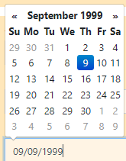
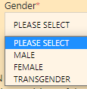
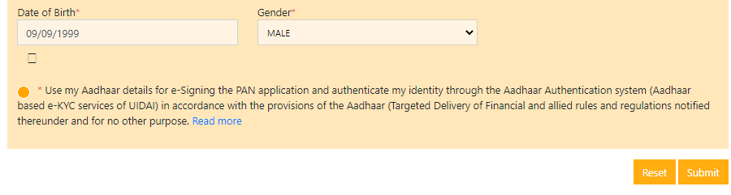
Steps for DOB and Gender inputs
Fil in the Date of Birth using MM/DD/YYYY Or select from the calendar .
Age must not be less than 18yrs
Select the last option by clicking * use my Aadhaar details for e-signing.
Press Submit for next screen.
Altruist confidential and proprietary
Altruist confidential and proprietary

Slide 8
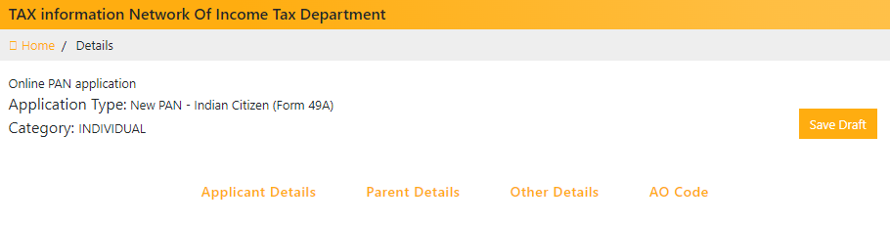
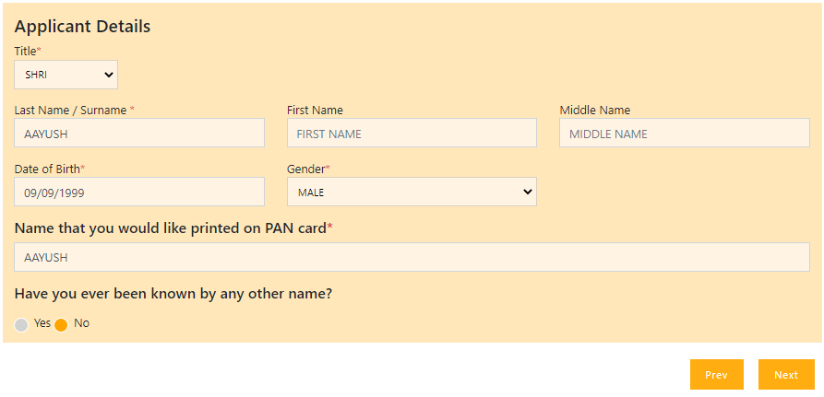
Steps for Tax information
Altruist confidential and proprietary
Altruist confidential and proprietary

Slide 9
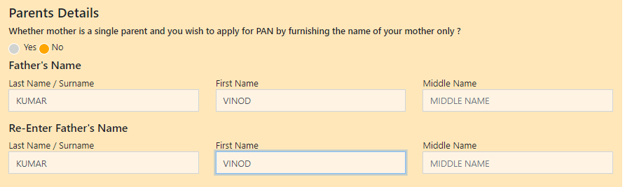
Steps for Parents details
Fill in the parent details based on Instructions
Altruist confidential and proprietary
Altruist confidential and proprietary

Slide 10
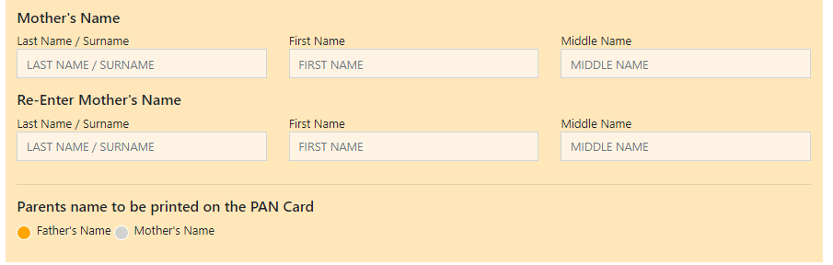
Steps for acknowledgement receipt generation & Digitization
Mother's name is not mandatory in case father’s details are filled
Altruist confidential and proprietary
Altruist confidential and proprietary

Slide 11
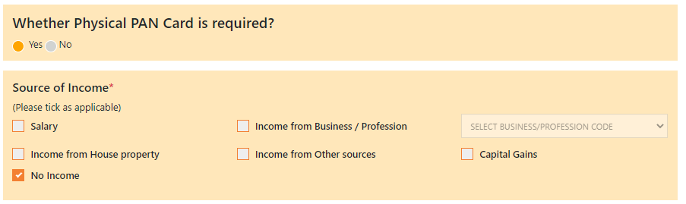
Selection for Physical or Paper card.
Select Yes if physical card is required the charges will be 107/-
If physical PAN is not required charges will be 72/-
Select Source of income.
Altruist confidential and proprietary
Altruist confidential and proprietary

Slide 12
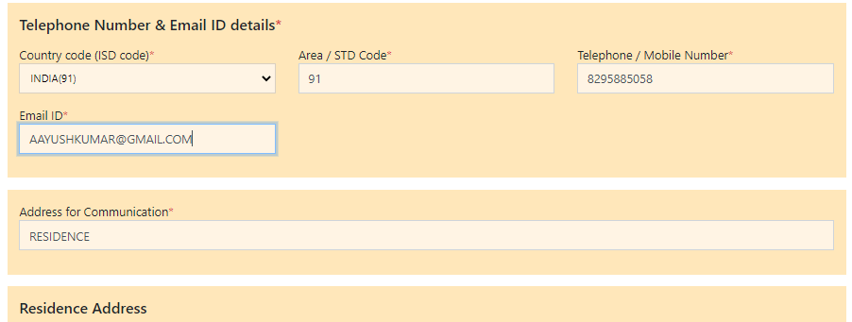
Steps for Mobile and area code
Fill in the STD code as 91
Telephone no. with STD or Mobile no.
Email address – Pl ensure this is correct as you will receive ePAN on this email address.
Altruist confidential and proprietary
Altruist confidential and proprietary

Slide 13
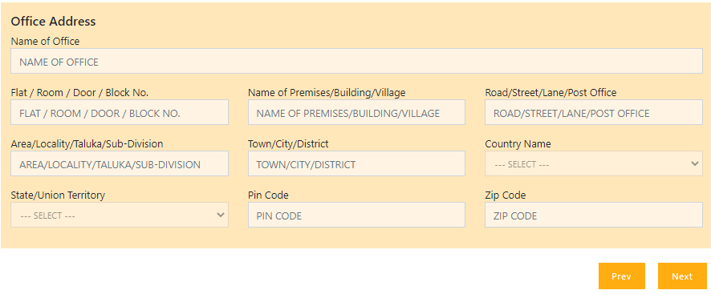
Steps for office information
Office information is not mandatory .
Altruist confidential and proprietary
Altruist confidential and proprietary

Slide 14
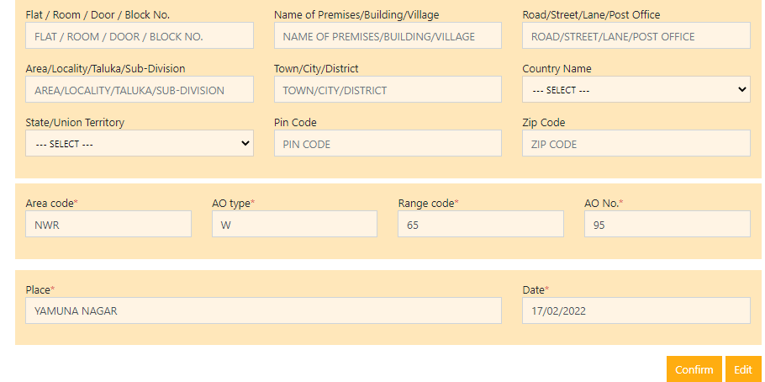
Steps for Address and Area
Address will be auto filled with Aadhar ..as mentioned in the Aadhaar card.
Input state , Pin and Zip
Altruist confidential and proprietary
Altruist confidential and proprietary

Slide 15
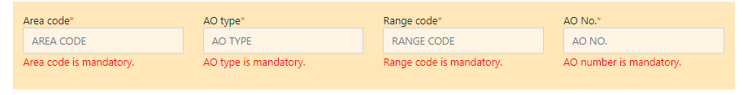
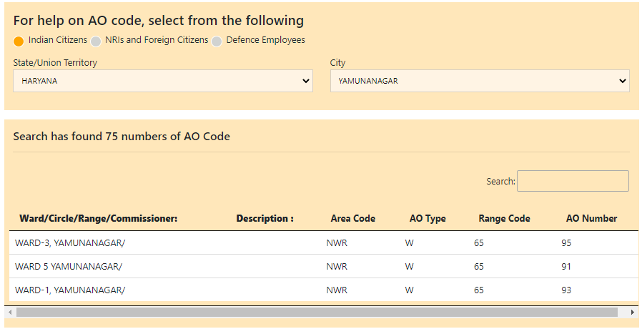
Steps for acknowledgement receipt generation & Digitization
For Area code first select the State and City
It will display Ward/Circle/Range as below select one of them Area code will be populated accordingly.
Altruist confidential and proprietary
Altruist confidential and proprietary

Slide 16
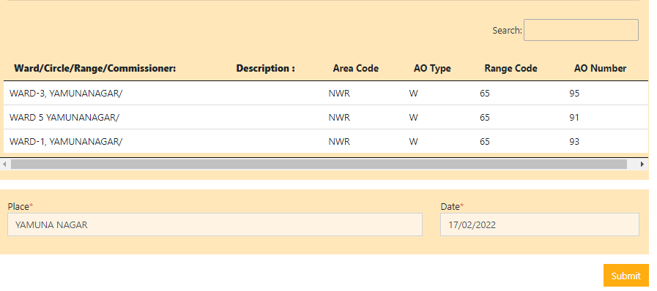
Steps for acknowledgement receipt generation & Digitization
Press submit
Altruist confidential and proprietary
Altruist confidential and proprietary

Slide 17
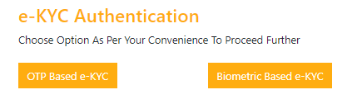
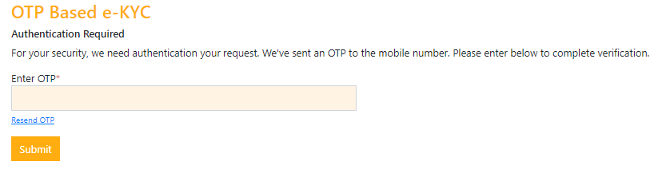
Steps for KYC thru OTP
You will get this screen for KYC
Select OTP in case your Aadhaar is linked to your Mobile.
The customer will get an OTP on your mobile .
Type the OTP Here and submit, it not received resubmit
Altruist confidential and proprietary
Altruist confidential and proprietary

Slide 18
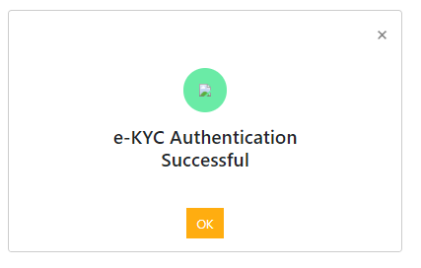
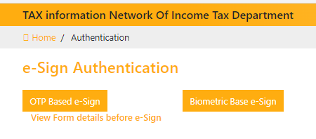
Steps for E-Sign Aadhaar Authentication
Press OK to move to the next screen for Aadhaar Authentication
Select OTP based e-Sign
Altruist confidential and proprietary
Altruist confidential and proprietary

Slide 19
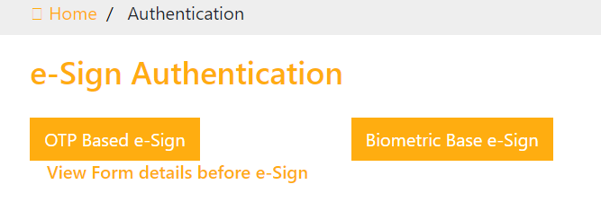
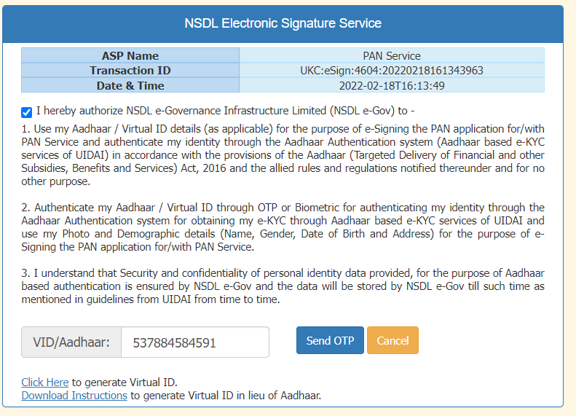
Verification thru OTP
On this screen pl enter the Aadhar card no.
Altruist confidential and proprietary
Altruist confidential and proprietary

Slide 20
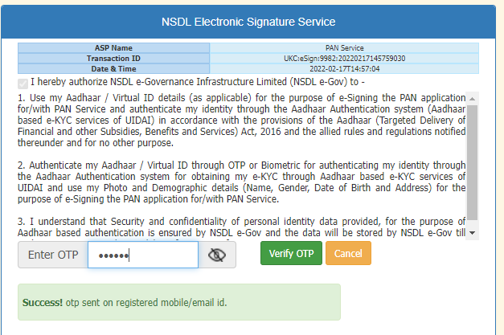
Verification thru OTP
On this screen first select send OTP
Then type the received code and press verify OTP
Altruist confidential and proprietary
Altruist confidential and proprietary

Slide 21
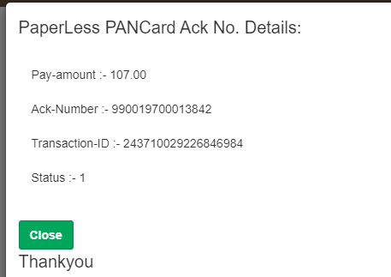
Acknowledgement generation
You will receive the Acknowledgement no.
Payment Amount
Transaction ID on the
Screen
Email
SMS
Altruist confidential and proprietary
Altruist confidential and proprietary

Slide 22
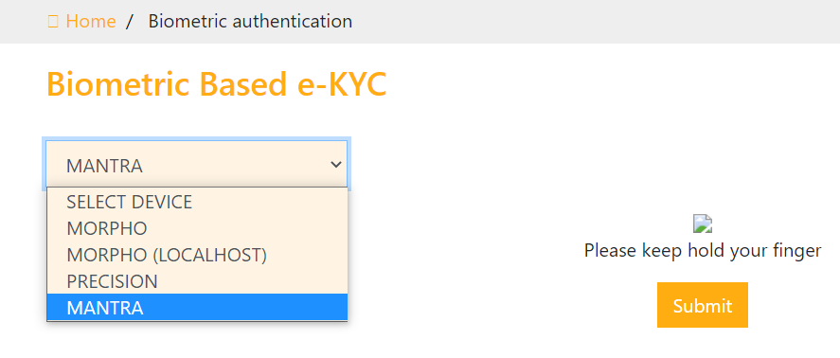
Biometric Authentication
In case the Mobile of the customer is not linked to Aadhaar he can do his authentication from biometric device.
Altruist confidential and proprietary
Altruist confidential and proprietary

Slide 23
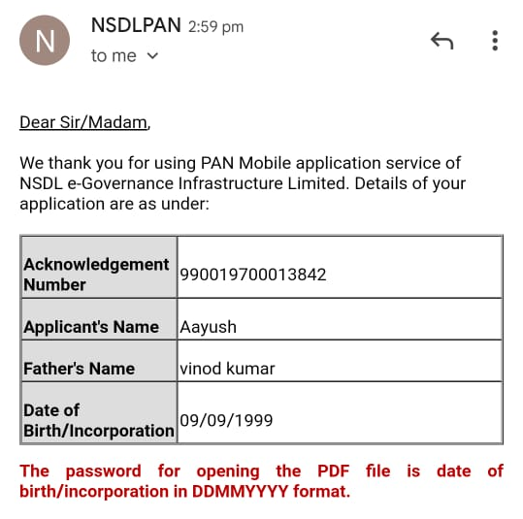
Acknowledgement on Email
Altruist confidential and proprietary
Altruist confidential and proprietary

Slide 24
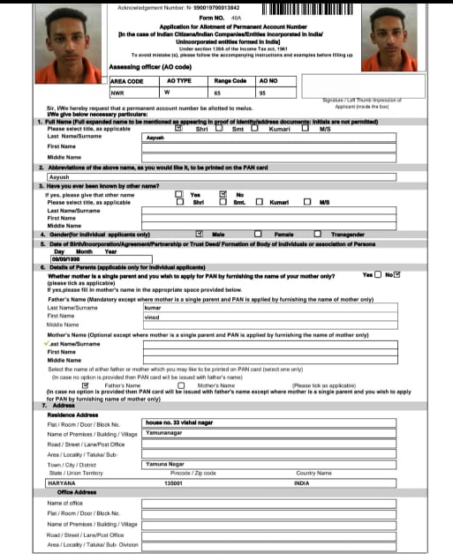
PAN on Email
Altruist confidential and proprietary
Altruist confidential and proprietary

Slide 25
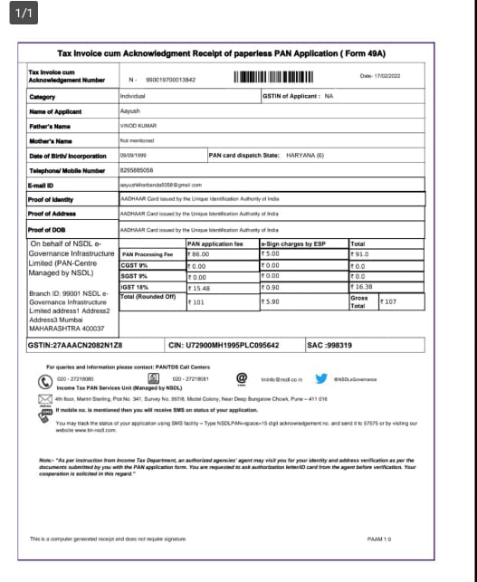
PAN details on email
Altruist confidential and proprietary
Altruist confidential and proprietary

Slide 26
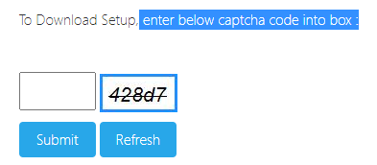
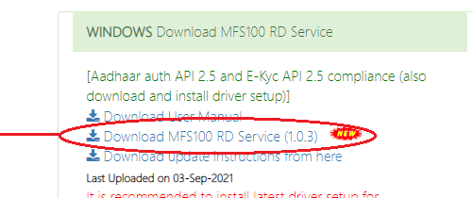
Acknowledgement generation
Go to Mantra site
https://download.mantratecapp.com/forms/downloadfiles
From the site first Download , unzip and install
Altruist confidential and proprietary
Altruist confidential and proprietary

Slide 27
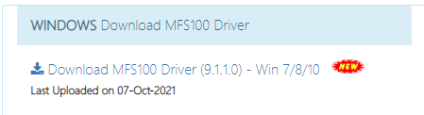
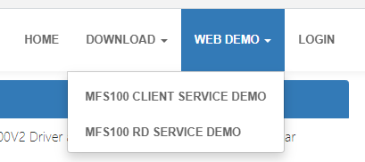
Acknowledgement generation
Then download , unzip and install MFS100 Driver
Check the device is working or not on the same site click WEB Demo or Go to Mantra site given below :
https://rdtest.aadhaardevice.com/
Altruist confidential and proprietary
Altruist confidential and proprietary

Slide 28
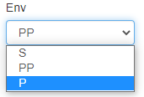
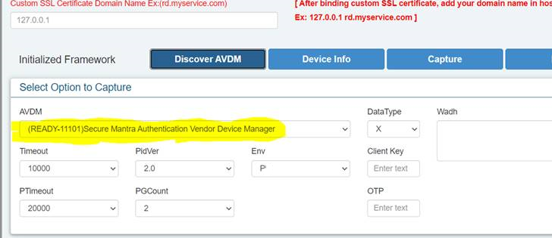
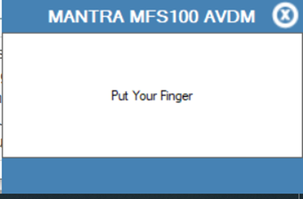
Acknowledgement generation
In the screen pl change the option to “P”
Select Capture the light will glow , place your figure once you see this message.
Altruist confidential and proprietary
Altruist confidential and proprietary

Slide 29

Mantra trouble shooting
If the device is still not working pl follow the below steps
Pl check the config file in the below path
Check setting below …If “P” it is OK else change to “P” and save the file
Altruist confidential and proprietary
Altruist confidential and proprietary

Slide 30
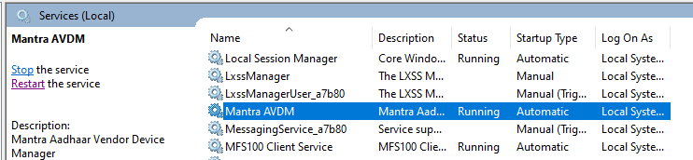
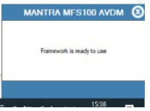
Trouble shoot step 2
3) Go to windows and open ‘services.msc’. Restart the below listed “Mantra ADM” service. If any other service of Mantra is running then please stop the same.
4) Plug the device to machine. If all setup is successful then you should get the below popup.
You will get the below message
Altruist confidential and proprietary
Altruist confidential and proprietary

Slide 31
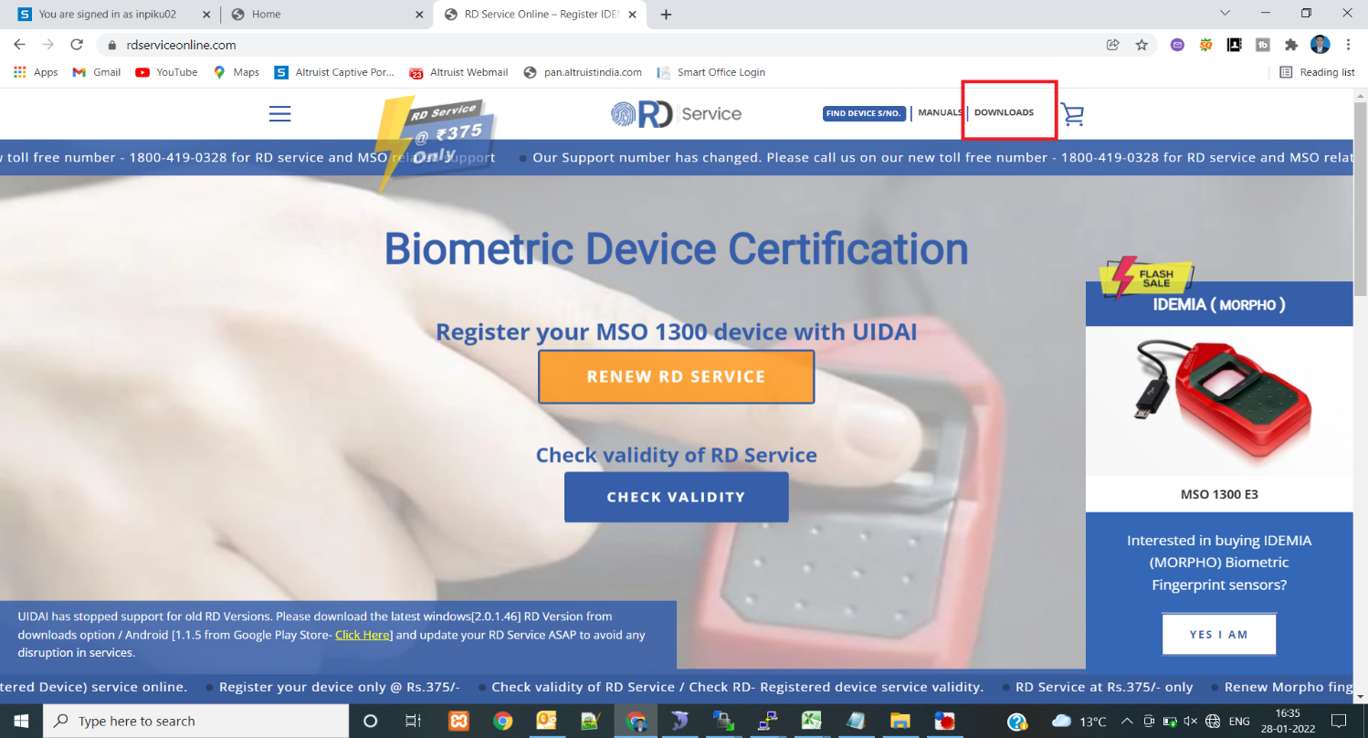
Trouble shooting for Morpho Device
STEP 1:- Go to MORPHO site LINK BELOW :
https://rdserviceonline.com/
STEP 2:- THEN GO TO DOWNLOADS :
Altruist confidential and proprietary
Altruist confidential and proprietary

Slide 32
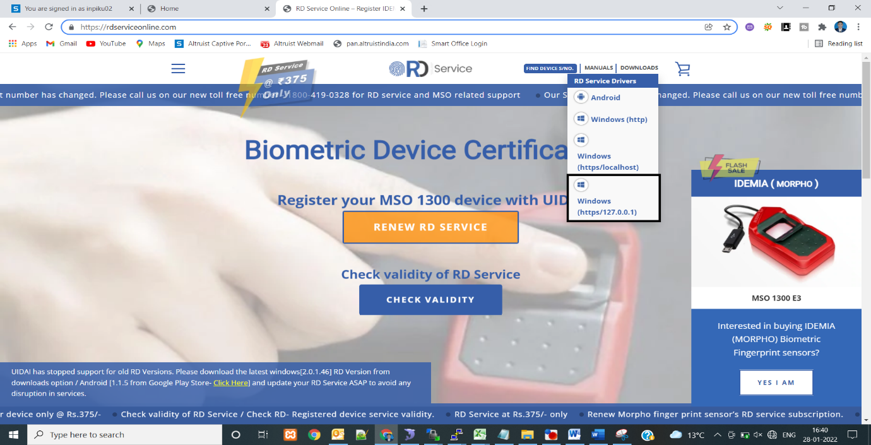
Acknowledgement generation
STEP 3 :- THEN DOWNLOAD TO MARKED :
Altruist confidential and proprietary
Altruist confidential and proprietary

Slide 33
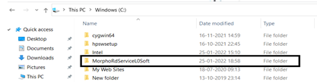

Acknowledgement generation
STEP 4:- GO TO ( C:) FOLDER AND THEN CLICK MARKED NAME :
STEP 5 :- THEN GO ConfigSetting MARKED AND OPEN :-
Altruist confidential and proprietary
Altruist confidential and proprietary

Slide 34
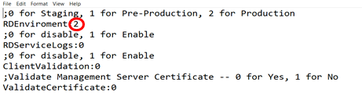
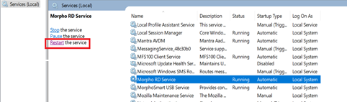
Acknowledgement generation
STEP 6 :- IF RDEnviroment is 2 THEN ITS OK OTHERWISE DO 2.
STEP 7:- THEN CLICK IN WINDOW AND SEARCH IN SERVICES THEN FIND Morpho RD Service and RESTART The device SHOW IN MARKED :
Altruist confidential and proprietary
Altruist confidential and proprietary

Slide 35


Acknowledgement generation
1) Settings for Morpho Device:
Install morpho device drivers & RD services in machine.
2) Go to below path:
3) Open ConfigSettings file in Notepad. Make changes as mentioned below and save the file. Check below settings. The RDEnviorment Mode should be 0
Go to windows and open ‘services.msc’. Restart the below listed 2 services of Morpho
Altruist confidential and proprietary
Altruist confidential and proprietary

Slide 36


Acknowledgement generation
Go to Chrome browser type chrome://flags
Then search “Allow invalid certificates for resources loaded from localhost “
should be Enabled.
Once enabled press Relaunch from right bottom of screen.
Altruist confidential and proprietary
Altruist confidential and proprietary

Slide 37

Acknowledgement generation
6) Go to windows and open “Resource Monitor”. The TCP Port of Morpho device should be 11100. Find below the screen shot for reference.
Altruist confidential and proprietary
Altruist confidential and proprietary

Slide 38

Thank You
Altruist confidential and proprietary
Altruist confidential and proprietary

